Slide 1


Distributed Denial of Service Attacks in MySQL Databases
A Distributed Denial of Service (DDoS) attack is a malicious attempt to disrupt the normal functioning of a website or online service by overwhelming it with traffic from multiple sources.
by Mayuri Londhe

Slide 2
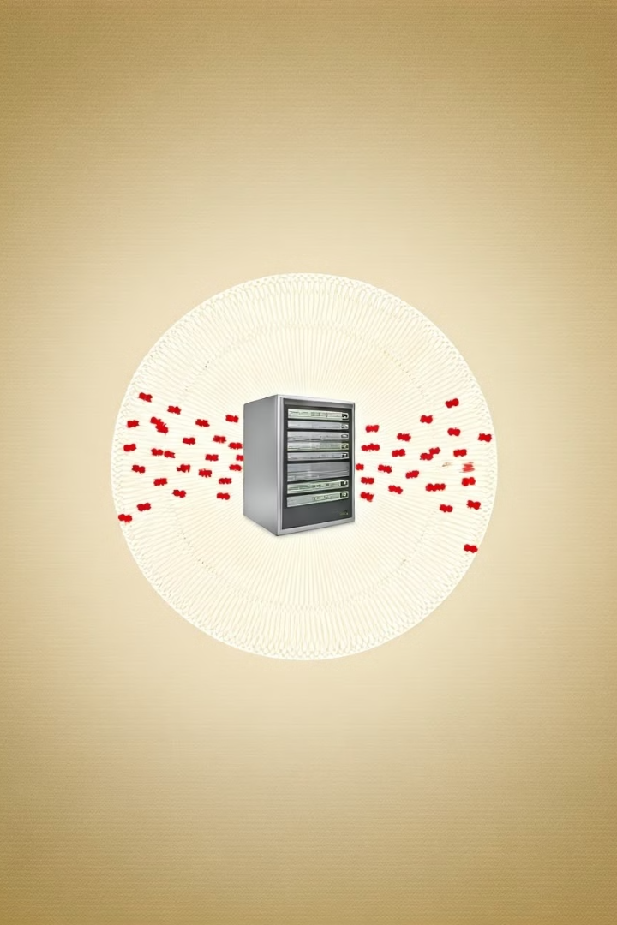
How DDoS Attacks Work
1
Botnet Creation
Attackers gather a network of compromised computers known as a botnet to generate the overwhelming traffic volume.
2
Traffic Generation
The botnet is instructed to send requests to the target server, flooding it with malicious traffic from numerous sources.
3
Traffic Flood
The target server becomes overwhelmed by the sheer volume of incoming traffic, leading to a denial of service for legitimate users.
4
System Overload
The server's resources are exhausted, causing it to slow down or crash, making it inaccessible to legitimate users.

Slide 3
Types of DDoS Attacks
Volume-Based
Protocol
Application
These attacks flood the target with massive amounts of data packets, consuming bandwidth and causing network congestion.
These attacks exploit vulnerabilities in network protocols, sending malformed or invalid requests, disrupting normal network operations.
These attacks target specific application layers, such as web servers, overwhelming their resources and causing them to become unresponsive.

Slide 4

DDoS Attack Techniques
1
Botnets
2
Malware
A network of compromised computers controlled by an attacker, used to generate massive amounts of traffic.
Malicious software installed on victims' devices to turn them into bots, contributing to the botnet.
3
Scripting
4
Amplification Attacks
Scripts can be used to automate the process of generating malicious traffic, making attacks more efficient.
Exploiting vulnerabilities in DNS or NTP protocols to generate significantly larger amounts of traffic than the attacker initially sends.

Slide 5

Protecting Against DDoS Attacks
Firewalls
Intrusion Detection Systems
Act as a barrier, filtering out malicious traffic based on predefined rules, preventing it from reaching the target server.
Monitor network traffic for suspicious activity, identifying and blocking DDoS attacks before they can cause significant damage.

Slide 6




Real-time Scenario: Targeting a MySQL Database
Attacker's Goal
The attacker aims to disrupt the database server, making it unavailable to legitimate users.
Attack Method
They use a botnet to send a massive number of requests to the MySQL server, overwhelming its resources.
Impact on Database
The database becomes overloaded, resulting in slow response times or complete denial of service for legitimate users.

Slide 7

Mitigating the Impact of DDoS Attacks on MySQL Databases
Technique
Description
Rate Limiting
Restricting the number of requests from a single IP address within a given time frame.
Blacklisting
Blocking known malicious IP addresses from accessing the database server.
Database Caching
Storing frequently accessed data in memory, reducing the load on the database.
Load Balancing
Distributing traffic across multiple servers, preventing any single server from being overwhelmed.

Slide 8




Conclusion and Key Takeaways
Security
DDoS attacks pose a significant threat to the availability and reliability of online services, highlighting the importance of robust security measures.
Protection
Organizations must implement comprehensive security strategies, including firewalls, intrusion detection systems, and other security measures, to mitigate the risk of DDoS attacks.
Network Monitoring
Constant monitoring of network traffic is crucial to detect and respond to DDoS attacks in a timely manner.

